Slide 1
The American Colonies

Slide 2
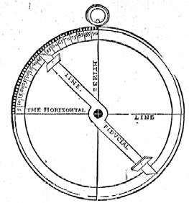
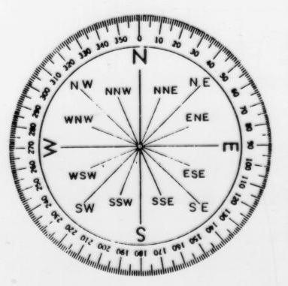
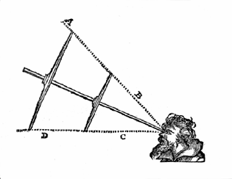
Keys to the New World
Astrolabe
Compass
Cross staff
Latitude and longitude
These 15th century inventions made it possible to venture across the harsh, unforgiving Atlantic

Slide 3
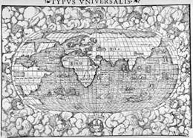

Slide 4
The Lost Colony
Because the Tudor dynasty wisely bolstered the Royal Navy, 17th century England was prepared to establish colonies in the Americas. Queen Elizabeth commissioned Sir Walter Raleigh and Sir Francis Drake to explore for colony potential
Not willing to antagonize the Spanish hold in Latin America, the logical choice was the North American Atlantic seaboard
Raleigh established an ill-fated colony on Roanoke Island (outer banks of N Carolina) 1585. Named “Virginia” in honor of the Virgin Queen
Hostile inhabitants, weather and sandy soil forced abandonment in Spring 1586
A second attempt with 117 colonists in 1587 under John White faced starvation. White returned to England to secure supplies but was delayed in returning by Spanish Armada’s attack on England
When White returned in 1590, the 117 vanished without a trace and only the words “Croatoan” carved into wood stood as a clue to their fate. No Indian tribes are Croatoan. White’s grand daughter Virginia Dare, having the distinction of being the first English child born in North America was among the missing

Slide 5
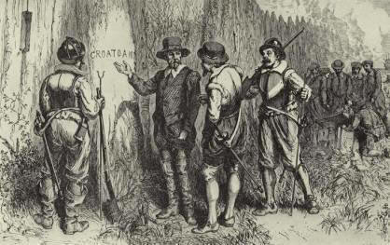
John Smith sought information about the fate of the colonists in 1607. One report indicated that the Lost Colonists took refuge with friendly Chesapeake Indians, but Chief Powhatan claimed his tribe had attacked the group and killed most of the colonists. Powhatan showed Smith certain artifacts he said had belonged to the colonists, including a musket barrel and a brass mortar. The Jamestown Colony received reports of some survivors of the Lost Colony and sent out search parties, but none were successful.

Slide 6
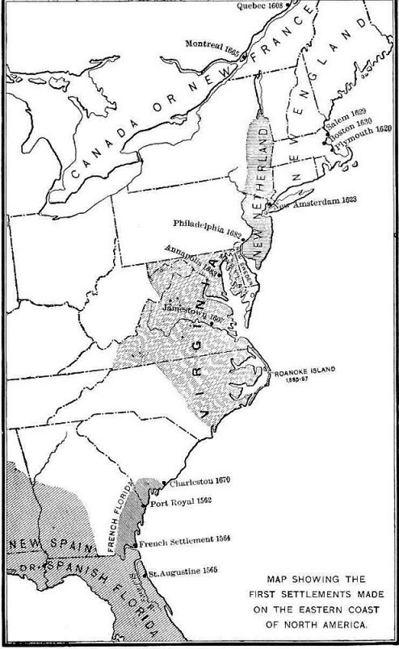
rival monarchies of France, Holland and England ran to establish footholds in the Americas where the Spanish were not: the Atlantic seaboard of North America. These areas had decided disadvantages: no tropical climate to grow lucrative crops such as sugar (tobacco had not been introduced yet), British and French explorers failed to find a northwest passage to India, hostile Indians and harsh winters.

Slide 7
Canada
Unlike the Spanish, the French worked to establish an uneasy relationship with the Indians. Their alliance serve to prosper both: the Indians knew how to grow hardy crops that would provide an abundance of food, the Europeans supplied weapons and technology. The fur trade flourished. But in establishing friendly relations with the northern tribes they inevitably made enemies if the southern tribes. The Iroquois were particularly formidable. Unlike their surrounding tribes, Five Iroquois Nations banded together forming a Great League, dedicated to mutual non-aggression inwardly and focused a lifestyle of warfare outwardly.
The French established their colonies in the north despite the short growing season because it avoided any conflict with Spain, the St Lawrence River extended deeper into the interior of North America than any other waterway. Thus was the beginning of Canada, derived from Huron-Iroquois word for village “Kanata”. The principle establishment was Fort Quebec easily accessible by ship down the St Lawrence River.
Despite attempts by French Jesuits to reach the Indians, they were reluctant to convert to Catholicism.

Slide 8
New Netherlands
Henry Hudson navigated the Hudson River and in 1609 established a Dutch trading post at what is now Albany, New York. The Dutch established mutual trade agreements with the eastern nations of the Iroquois or Mohawks and built Fort Orange to control the Hudson River.
The Mohawks called the Dutch “Kristoni” or metal-making people. Ironically, the Iroquois exploited the Dutch for weapons and then used them in their warfare against the French. Unlike the Indian tribes dominated by the Spanish, the Iroquois Five Nations people took advantage of the European settlers and dominated all the competing Indian tribes in North America.
The Dutch settlement at the mouth of the Hudson (now New York City) was named New Amsterdam and the colony extending the length of the Hudson River was New Netherlands.

Slide 9
The Virginia Colony
A more hospitable place was found at the mouth of the Chesapeake Bay on the James River.
In 1607 the first successful colony was established at Jamestown, a purely economic venture.
“to settle and plant our men and diverse other inhabitants there, to the honour of Almighty God, the enlarging of the Christian religion, and to the augmentation and revenue of the general plantation in that country, and the particular good and profit of ourselves.” John Smith
As adventurer farmers, the colonists faced the daunting task of clearing the wilderness and the hostile inhabitants for their plantations

Slide 10
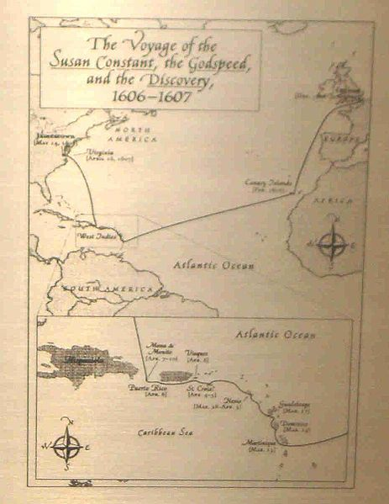
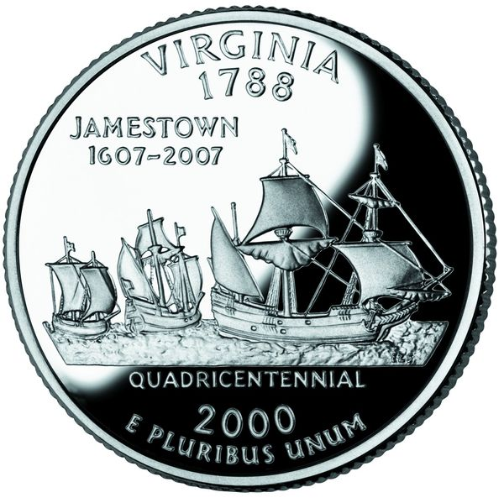
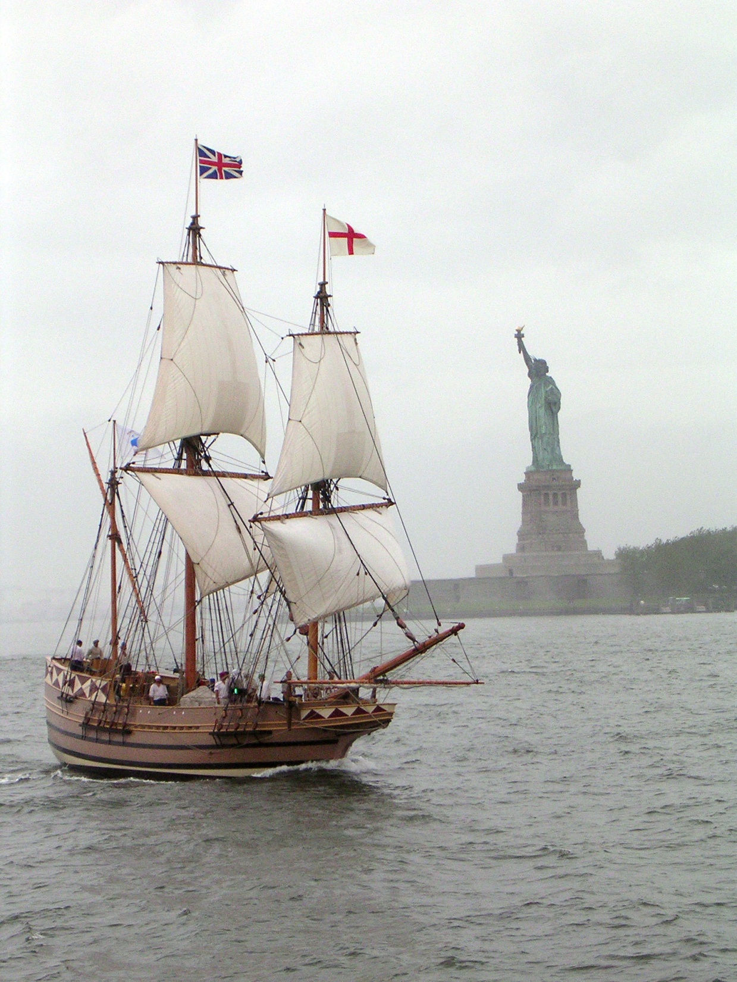

Slide 11
The Virginia Colony
The resourceful John Smith led the colony through the initial difficulties but was injured in an explosion and shipped back to England in 1608. Other leaders were incompetent, hoarding food and
As economic venture, it was a failure. Life was harsh. They alienated themselves with their native Americans neighbors:
The settlers first tried bullying their native neighbors to provide food, but this only resulted in violence as the Indians lashed back.
Of the original 104 inhabitants, only 38 remained alive after the first nine months of the “Starving Time”
Situated near swamps, the settlement was disease-ridden and trapped.
Its incompetent leaders were harsh, inflicting grievous punishment for even the slightest infraction. Many fled only to be recaptured and tortured
Relations with Indians were deplorable as they were viewed as less human

Slide 12
The Algonquian Empire
In the Chesapeake Bay region about 24,000 Indians of various tribes were united under a powerful “emperor”
The tribes shared in common the Algonquian language
Powhatan, shrewd 60 y/o sachem, subdued other tribes and retained their loyalty by marriage to their chief women or of his daughters to their chief’s sons
The capture of Capt John Smith was perhaps a similar attempt by Powhatan to acquire the English in his empire.
It is unclear whether the attempted execution was staged or real
It is also controversial whether Pocahontas intervened or not

Slide 13
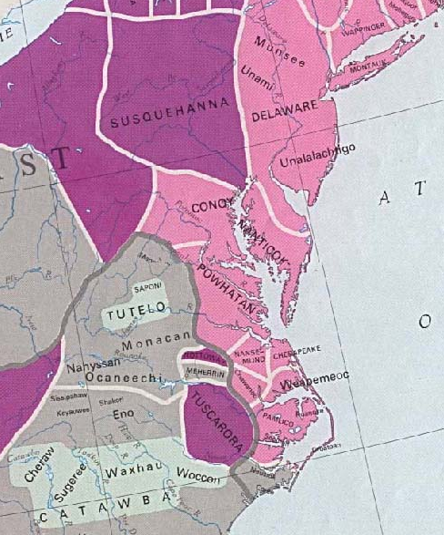
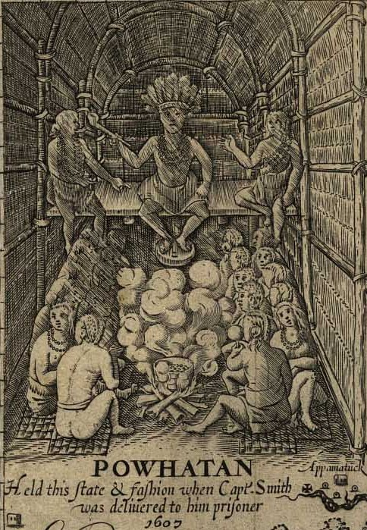

Slide 14
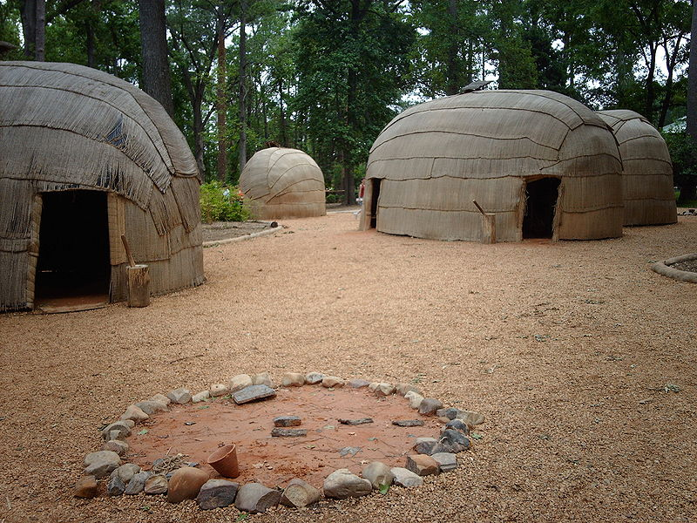
Powhatan Village 1607

Slide 15
In 1609, Rev. Robert Gray chided his fellow colonists,
“ The first objection is, by what right or warrant can we enter into the land of these Savages, take away their rightful inheritance from them, and plant ourselves in their places, being unwronged or unprovoked by them?”

Slide 16
A Proprietary Colony
Commissioned by King James to help reverse economic hard times besetting England after Elizabeth’s protracted war with Spain
Virginia Company chartered the colony under the company’s proprietary rule
proprietary colonies were formed by private companies which ruled them according to their own interests
The Starving Time brought the colony to verge of extinction
After six years the company still had nothing to show for its investment

Slide 17
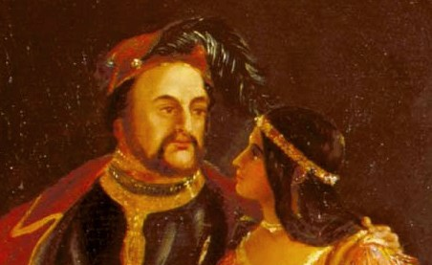
John Rolfe & Virginia Tobacco
In 1610 London businessman John Rolfe arrived at the colony with new, sweeter strain of tobacco from Trinidad. Taught by the Indians about tobacco, Rolfe saw this as the only crop which was marketable in England. He led the new farmers to cultivate tobacco for export.
By 1612, Rolfe's new strains of tobacco had been successfully cultivated and exported. Finally, a cash crop to export would make the colony profitable, and plantations and new outposts sprung up along the James River
In 1614, Rolfe married Pocahontas, solidifying the colony’s improving relationship with Powhatan. While returning from a tour of England, Pocahontas died of disease contracted there in 1617 at the age of only 21.

Slide 18
Renewed War 1622
Jamestown had 11 years of uneasy peace with Powhatan, who reluctantly traded with English but had become increasingly “ineffectual”
Following his death in1618, his younger brother Opechancanough became chief of the Powhatan confederacy
The natives and the colonists came into increasingly irreconcilable conflicts as the land-hungry cash tobacco brought in more and more colonists
In 1622, the Chief abandoned diplomacy and on March 22, 1622, stage simultaneous surprise attacks
destroying the outlying plantations and killing 347 colonists, nearly a third of the population.
The remaining colonists retreated to the fortified settlements in Jamestown.

Slide 19
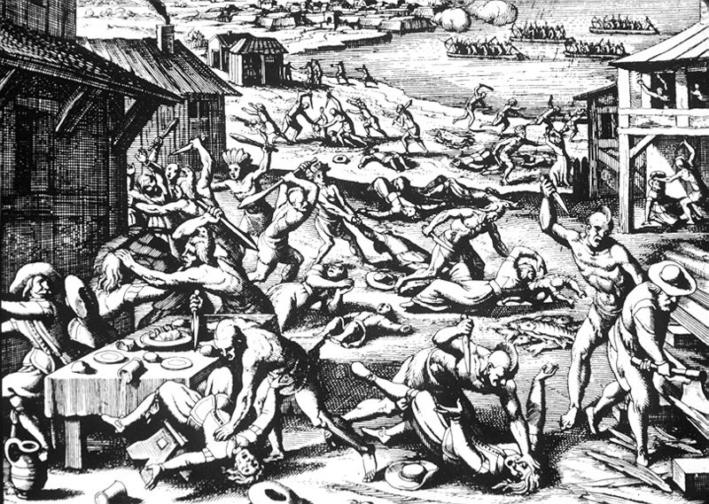

Slide 20
Brutal Retaliation
Regrouping, the colonists retaliated killing hundreds of Indians. At one point a feigned truce was called and in a toast to the new peace, the drinks of 250 native leaders were tainted with poison and they died
Dr John Potts gained noteriety as the one who prepared the poison
His Middle Plantation became the city of Williamsburg in 1699
Opechancanough who wanted no part in a treaty with white men, continued to afflict the Englishmen with violence until 1632 but his power was dwindling.
The English forced a peace treaty upon him which extorted large areas of coastal land along the Rappahannock and Potomac Rivers for further settlements.

Slide 21
Powhatan Confederacy Decimated
In 1644, Opechancanough made one last attempt to rid the area of colonists. This surprise attack killed more than 400 settlers
English counterattacks drove the Algonquian tribes from the coastal areas
In 1646, Opechancanough was caught and captured but then murdered by an angry soldier in captivity. He was over 100 years old.
More devastating still was the disease that raged through the Indians. By 1669, a mere 2,000 of the Algonquian-speaking tribes remained
In contrast the colonial population of Virginia had risen to 41,000 by 1670.

Slide 22
The Growing Colony
Prophetically, King James I disdained the habit of smoking tobacco as “ a custom loathsome to the eye, hateful to the nose, harmful to the brain...dangerous to the lungs.”
But the large revenues derived from importing tobacco to England caused the Crown to look the other way.
Finally, things were looking better for Jamestown. Incredibly, the tobacco enterprise expanded from 200,000 lbs exported in 1624 to over 3,000,000 lbs by 1638.

Slide 23
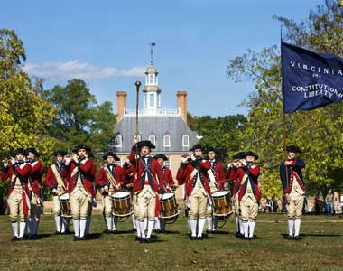
Virginia, A Royal Colony
In the meantime, the Virginia Company teetering on the verge of bankruptcy, had its charter terminated in 1624 and the Crown took over administration.
In royal colonies, the Crown appointed a governor.
Governor ruled by favor of King Charles I
Assembly was legislative body empowered to set governor’s wages, the reward for ruling well
Eventually the government would be established in Williamsburg in1699

Slide 24
The Indentured Servants
With the growing plantations, came a growing need for labor
Many young men from Ireland, Scotland, England and Germany came to America subject to terms of indenture.
This was a contractual agreement to serve 3 to 7 years in exchange for the trans-Atlantic voyage, food, clothing and lodging

Slide 25
Slavery Introduced
These plantations soon outstripped the availability of laborers to do the tilling, planting, harvesting and packaging tasks.
The 3 to 7 year terms of indenture had long expired and with the falling of tobacco prices, new contracts were not forthcoming as there was dwindling desire to come to America under such conditions.
Gradually, the land owners turned to slaves. The Indians could not be made slaves because their culture had associated farm work with women and the men refused to assume such roles.
The slaves were imported from Africa, where the ever growing slave trade was prospering.
While in 1650 there were only 300 slaves in all of the royal colony of Virginia, this number rose to 13,000 by 1700 and to 150,000 by 1750, nearly 40% of the colony’s entire population!

Slide 26
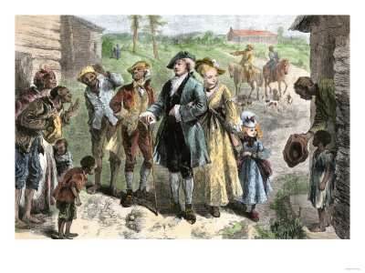
Life of Slaves
In 1670 there were no systematic laws regarding slaves. More commonly, masters allowed slaves to acquire their own property. Some even managed to purchase their freedom and as freemen, enjoyed all the right and privileges of English citizens as colonial society had, at first, class distinctions but not racial barriers. They could travel as they pleased, vote, procure firearms, buy and sell land and even own slaves.

Slide 27
As the number of African slaves grew toward the end of the seventeenth century and they more readily maintained their own culture, the laws began to be changed against them and their living conditions became more rigorous.
As more of the slaves were Blacks with time, skin color began to be equated with whether a man was a slave or free.
Even the free Black men lost their privileges and some had to leave Virginia.
Justice was delivered with partiality against Blacks and in favor of Whites.
Some planters resorted to brutality against their own slaves with relative impunity from the law.
As more and more property was taken up by elite white plantation owners, the poorer whites, began to turn to the frontier for their future.
They would much rather face the hazards of the wild than risk the prospects of becoming slaves.

Slide 28
Virginia Split
In contrast, Virginia, now a royal colony was very sympathetic to the King’s bidding
The King had right to grant land to loyal subjects, accordingly, Charles I sought regulate the colonies by granting land to courtiers
Roman Catholic courtier George Calvert (Lord Baltimore) was granted a proprietary rights in 1632
New area within territory of Virginia
Government of colony was vested in Baltimore family, with supreme power of appointment & regulation
Named colony Maryland after Queen Henrietta Maria
Religiously tolerant by necessity because the patent specified Anglican religion but family was Catholic

Slide 29
New England
In 1622 a very different colony
Huddled in the bowels of the Mayflower, men, women and children braved the perilous journey across the Atlantic in search of a new beginning.
These Puritans fled their homeland England during the persecutions staged during the reign of King Charles I.
At first they went to the Protestant stronghold of Holland. But unable to find jobs among the competitive Dutch, they resigned themselves to seeking another place to practice their faith.

Slide 30
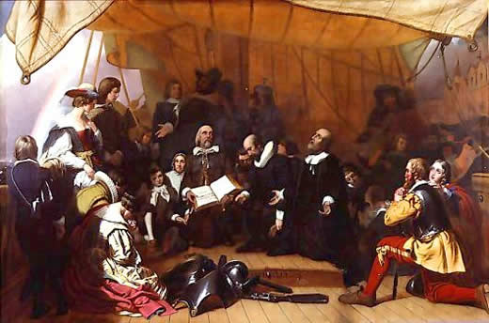

Slide 31
The New England colony was very different from Virginia. There was no economic motive for the Puritans to settle in New England. They needed to work hard to survive because there was too much work for too few colonists. The Puritan ethic was the key to their survival and the Providence of God.
New England farms, workshops, mills churches and schools were all a reflection of Puritan motives to glorify God through labor as their calling of God.
“We teach that only doers shall be saved, and by their doing and not for their doing.”

Slide 32
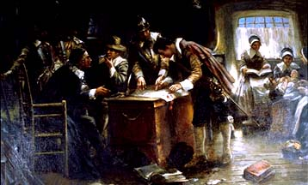
Charter Colony
New England was uniquely different than Virginia.
Plymouth existed without a formal charter from its foundation in 1620 until it was annexed by Massachusetts Bay colony in 1691.
Financial support from London evaporated in1627
Plymouth was left to their own resources
But its members compacted together to be subject to English law as it was in their homeland = Mayflower Compact

Slide 33
No Slaves in New England
Reliance on all members of the family to labor made New England farms more egalitarian. There were no slaves.
In all their hard work, the Puritans were intolerant of Catholicism and ritualism and were harsh on the unruly and decadent.
The Puritans blamed loose morals, an overemphasis on pleasure, indolence and the indulgent government for all the social and economic crises of England. They felt that England would be cleansed of poverty and crime if godly men and women would take over the leadership of the Church of England and the government and introduce a moral and spiritual rigor to both.

Slide 34
New England Tribes
The Indian tribes in the New England region had in common the Algonquian language but that is where the ties ended. There were the Mohegan and Pequot of Connecticut, the Narragansett of Rhode Island, the Patuxet and Wampanoag of Plymouth and the Nipmuck, Massachusett and Pennacook of Massachusetts Bay.
Unlike their Virginia counterparts, these native Americans were not united and had very separate chiefdoms. Each had a leading sachem (chief) assisted by a council of lesser sachems, shamans and prestigious warriors. The Shaman was an intermediary between the spirit world and the human world and a healer. He was an expert in herbal remedies.
The sachem ruled by earned respect, gentle persuasion, honorable example and generous gift-giving rather than coercion. More honor and distinction was given to the sachem who generously shared their food and deerskins rather than hoarded their material wealth. This was especially true in spring when the time of harvest was long spent. No one went hungry unless all starved. Hospitality and generosity were fundamental duties and a sign of ongoing friendship.

Slide 35
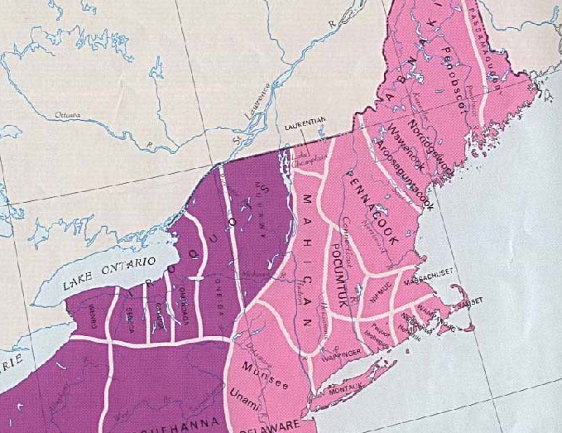

Slide 36
Tribes of New England
First virtually all tribes developed coherent religious systems that included cosmologies—creation myths, transmitted orally from one generation to the next, which purported to explain how those societies had come into being.
Second, most native peoples worshiped an all-powerful, all-knowing Creator or “Master Spirit” (a being that assumed a variety of forms and both genders). They also venerated or placated a host of lesser supernatural entities, including an evil god who dealt out disaster, suffering, and death.
Third and finally, the members of most tribes believed in the immortality of the human soul and an afterlife, the main feature of which was the abundance of every good thing that made earthly life secure and pleasant.

Slide 37
The Algonquian division of labor was simply by gender. Men’s work consisted of periods of intense exertion in which they traveled extensively from their encampment (especially in fall and winter) hunting, warring, building canoes, tools & weapons, alternating with periods of comparative ease (such as during the heat of summer). The women worked steadily year round, planting and harvesting maize, building and maintaining their wigwams (dwelling), dressing the animals and fish the men brought in, weaving baskets and mats and preparing meals. The children assisted by gathering nuts, shellfish, berries and herbs. It was considered shameful by each gender to assume activities assigned to the other by their culture.

Slide 38
The Algonquian tribes burned the forest twice a year to keep the underbrush clear. This facilitated hunting and rarely resulted in disastrous fires because there was no accumulation of kindling sufficient to burn tall trees.
There was no concept of “capital” or value in money. The only commerce involved mutual trading of usable items needed by neighbors. There was no ownership of land although the sachem distributed land for families to farm as they had need.
There was such a huge cultural gulf between the colonists and the Indians that the one could not comprehend the ways of the other. Agreements or treaties between them often held very different meanings to each of the parties involved. The agreeing parties were often completely unaware of the intents of their counterparts.

Slide 39
As the Puritan colony grew in population, the Englishmen attempted to buy land from the Indians, offering trade items as payments in exchange for paper deeds, for which the Indians had no notion of the European concept of private property.
The natives continued to hunt and fish during their annual cycles of mobility and were surprised and offended when the colonists abused or arrested them as trespassers.
Colonists with iron tools cleared the land of trees, vegetation and wild animals the Indians needed for food and their domestic cattle devoured the land, including the native crops. Sometimes the Indians lashed out or killed the livestock causing the colonists to regard them as inferior savage brutes who could not keep a treaty. During the 1630’s as two colonies of Massachusetts Bay and Plymouth expanded and formed an alliance, things grew worse. As the colonists made the land more familiar and profitable for themselves, they rendered it more alien and hostile to the Indians.

Slide 40
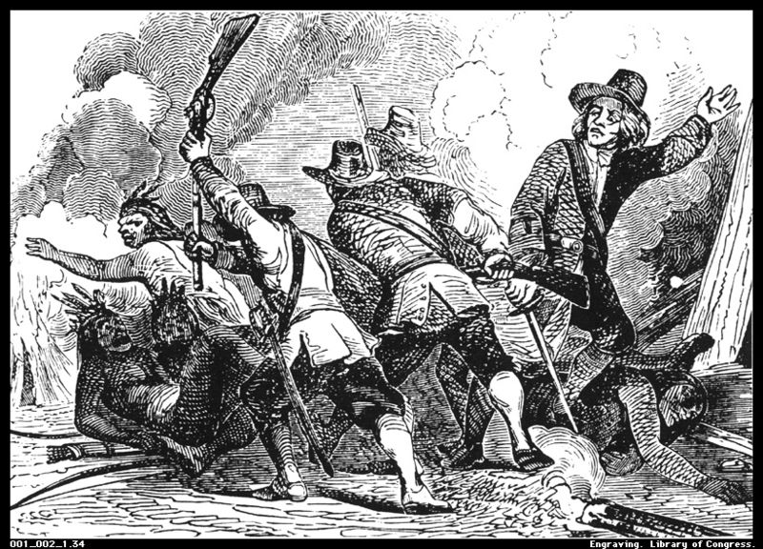
Pequot War
Tensions mounted as hostages were taken and murders were committed by both sides until in 1637, open conflict erupted between the Pequot tribes and the New England colonists and their Indian allies. With the increasing migrations of Indian tribes the Pequot aggressively pursued the control of the Connecticut River Valley. This made enemies of tribes already in the region, the Narragansett and the Mohegan.
The turn of events is somewhat controversial as the only remaining accounts of the war merely reflect the Puritan perspective. Regardless, the newly forming Connecticut colony, the Massachusetts Bay colony and the Plymouth colony allied with the Narragansett and the Mohegan to attack the Pequot.

Slide 41
The European style of warfare was a shock to their Narragansett and Mohegan allies. The indiscriminate slaughter contradicted Indian customs and they complained that the New England mode of war was “too furious and slays too many people.” Even the Puritan leaders in England protested the brutality of their colonial brethren. Only half of 3,000 Pequot survived the war, many of these were shipped off to the West Indies as slaves, the rest became subjects of the Narragansett and the Mohegan.

Slide 42
Praying Towns
Stung by the rebuke of others the New England Puritans belatedly began to evangelize the natives in 1640. Unfortunately, the Puritan missionaries exhorted the Indians to adopt the Puritan pace and mode of work. They formed praying towns where the men abandoned their hunting and fishing expeditions and adopted farming as the primary means of livelihood. Their women learned to spin and weave instead of plowing and harvesting. They worked hard for six days and observed the Sabbath the seventh. Ironically when the Indians read the Bible in their own language, they realized the faults and hypocrisies of the Puritan culture.

Slide 43
Vanishing tribes
For Indians of the larger tribes, the prayer towns were a contradiction to their cultural beliefs and shunned them accordingly. The smaller tribes caught up in the crisis of the shrinking country, sought them as a way to make sense of their catastrophes.
Unable to unite, the Indian tribes became rapidly shrinking minorities, many dying of disease epidemics such as smallpox. The land was dominated by the rapidly expanding colonial populations. By 1670, the combined population of the New England colonies of 52,000 outnumbered the Indians three to one.

Slide 44
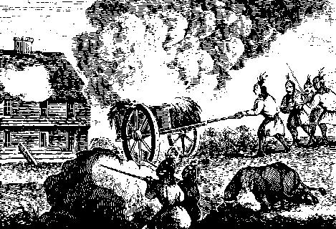
King Philip’s War
Wamsutta was the Grand Sachem of the Wampanoag confederacy was engaged in peaceful negotiations with the governor of the Plymouth colony when he mysteriously died. His brother Metacom took over
Metacom's open distrust of the colony came to a head when Wamsutta died, which he used as a pretext
War broke out in 1675 when many tribes united to attack New England settlers
War ended 1676 600 (1.5%) colonists and 3,000 (15%) Indians died
Receiving no help from England colonists depended on each other
the trials and tribulations suffered by the colonists gave them a national and group identity separate and distinct from subjects of the English Crown

Slide 45
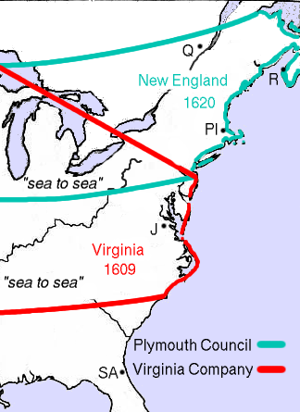
The Original two colonies extended west to the Pacific Ocean and divided the entire North American Atlantic seaboard

Slide 46
Massachusetts 1628
In 1630, more Puritans left England
Under format of Virginia (proprietary colony)
Formed Massachusetts Bay Colony
John Winthrop brought 1,000 settlers
“God will bring some heavy affliction upon this land (England) and that speedily; but be of good comfort…If the lord seeth it will be good for us, He will provide a shelter and a hiding place for us and others…Evil times are coming when the Church must fly into the wilderness.”
Colonists realized nothing in charter specified location of company… transferred all stock and directors to New England, founded Boston
By 1640 the population rose to 14,000 attracted by opportunity to own land

Slide 47
Dissenters
The government of Massachusetts was rigidly Calvinist and Puritan with little tolerance
Disputes broke out from those who disagreed with their theology (dissenters)
In 1635-6, some moved to form their own colony along Connecticut River & founded Hartford
A “Fundamental Order” or constitution proclaimed
Similar to Mayflower compact

Slide 48
Rhode Island
Roger Williams, ousted from Cambridge by Archbishop Laud, found Massachusetts Bay colony almost as oppressive
Lead idealists and “humbler folk” to form Providence
First political thinker of America
Influenced revolutionary ideas in not only America but also England.
agreed with his fellow settlers on an egalitarian constitution providing for majority rule "in civil things" and liberty of conscience”

Slide 49
Rhode Island
Incorporated many dissenters including Baptists who settled here in 1637 in land purchased by Anne Hutchinsun, Quakers and Jews
True religious freedom
Maintain friendly relations with Native Americans
Declared neutrality during king Philip’s War 1675-1676
Secured royal charter in 1660

Slide 50
New England
Despite religious divergences, the four colonies of New England were very similar
Plymouth, Massachusetts, Connecticut, Rhode Island
Quite independent of Great Britain
1635, Charles I sought to assert his authority over them
Colonies fortified and built block houses in preparation to resist invasion from England
English Civil War suspended any military action & colonies continued autonomously

Slide 51
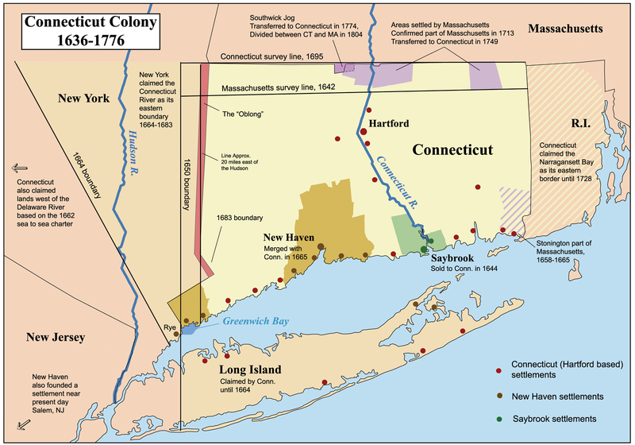

Slide 52
Charles II
Did much to settle the English in North America
Through his costly wars with Dutch, annexed their colonies in America as “New York”
Established proprietary colonies as grants to his courtiers:
Calvert was given Maryland
Penn given Pennsylvania
8 Lord Proprietors given Carolina
By end of his reign, England would control entire Atlantic coast of N. America (exc Florida) and population of settlers rose to ¼ million!

Slide 53
New Netherlands
Dividing the English colonies was the Dutch holdings along the Hudson River
early Dutch settlers planted the concept of tolerance as a legal right in North America as per explicit orders in 1624.
They had to attract, “through attitude and by example”, the natives and nonbelievers to God’s word “without, on the other hand, to persecute someone by reason of his religion, and to leave everyone the freedom of his conscience.”
When Governor Peter Stuyvesant
Stuyvesant had formally banned the practice of all religions outside of the Dutch Reformed Church
In particular, Quakers, Jews and Baptists were outlawed

Slide 54
Flushing Remonstrance
In 1656 William Wickenden, a Baptist minister from Rhode Island, was arrested by Dutch colonial authorities, jailed, fined, and exiled for baptizing Christians in Flushing.
English citizens, none of them Quakers, filed a petition to governor.
Those who signed were arrested, all but two recanted, placed on bread and water and jailed.
Town government was removed
John Browne arrested 1662 for harboring Quakers
Took petition to Amsterdam and had governor’s laws overturned, ending religious persecution

Slide 55
Becomes New York
While his brother Charles II was King, the Duke of York, James II, led a campaign to rid the Americas of Dutch control.
After three wars with Holland over 11 years, the English finally took over the Dutch colony in 1674
Named in Duke’s honor as New York
Retained Dutch character
Duke of York never visited his colony and exercised little direct control of it.
He elected to administer his government through governors, councils, and other officers appointed by himself. No provision was made for an elected assembly
He continued the Dutch policy of religious tolerance provided for by the Flushing Remonstrance

Slide 56
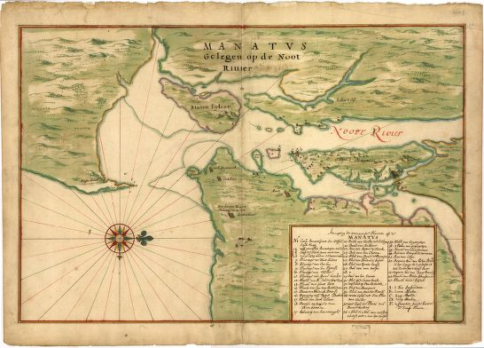
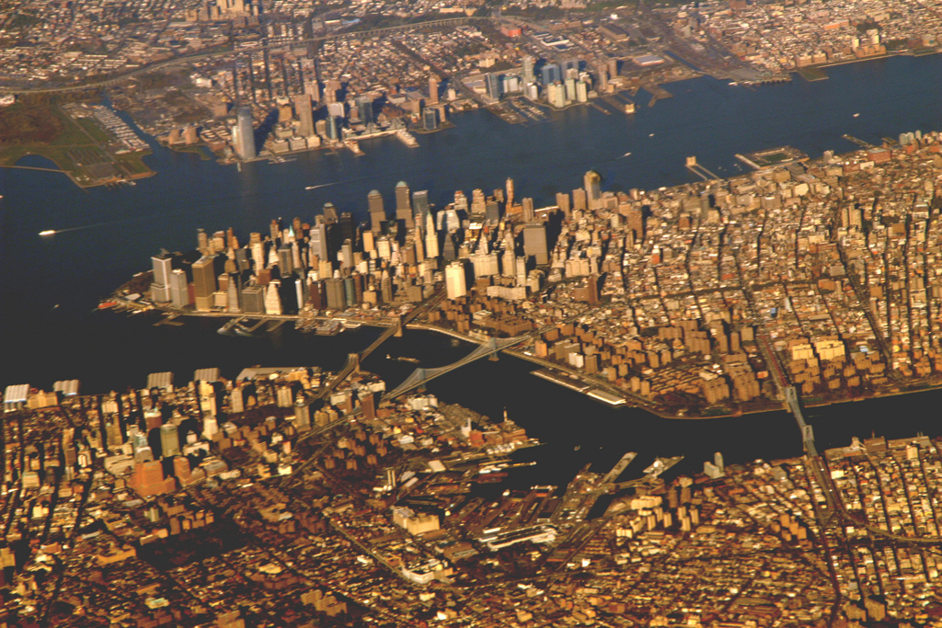

Slide 57
New York
The English replaced the Dutch as the allies of the powerful Iroquois Nation in their conflict with the French colonies in Canada.
From New York came New Jersey and Delaware

Slide 58
Pennsylvania
After securing the Hudson river from the Dutch, Charles II granted a royal charter to William Penn in 1681.
In his 1701 Charter of Privileges, Penn established a haven for persecuted Quakers from all over the world in Pennsylvania
In particular refugees from Germany (Pennsylvania “Dutch”)
he extended religious freedom to all monotheists and government was open to all Christians
As a royal colony, it had an appointed Governor and an elected Assembly

Slide 59
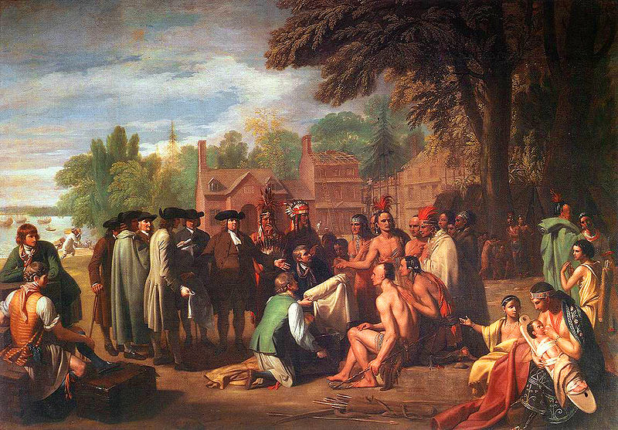

Slide 60
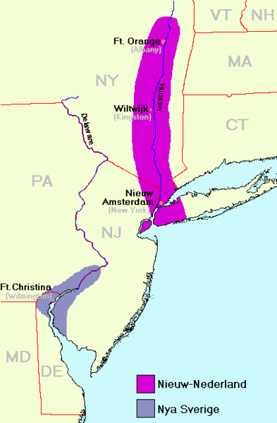
Delaware
Initially a Dutch establishment in 1631
Changed hands many times:
Swedes
Dutch
English (New York)
Maryland vs Pennsylvania
(Dispute between Penns and Calverts)

Slide 61
Delaware
A Dutch attempt to establish a fort here to protect whale ships failed when it was wiped out by Native Americans in 1632 after a misunderstanding
After this the Swedes held the area for 15 years until the Dutch regained control in 1655 under Peter Stuyvesant
After British defeated the Dutch in 1674, the area was originally part of New York
Under James II, two rival families of the King’s courtiers, the Calverts (Maryland) and the Penns (Pennsylvania) made overlapping claims to the land

Slide 62
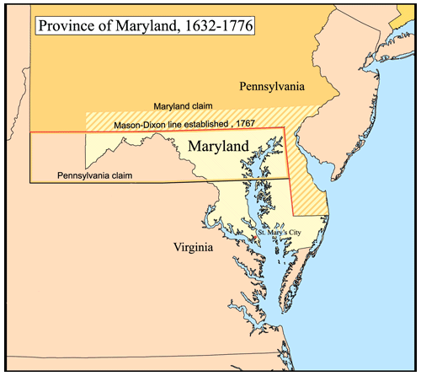
Mason Dixon Line
The problem remained disputed for 80 years until the Crown (George III) intervened in 1760.
Survey team of Mason and Dixon was commissioned to map out a compromise
King George forced the suing parties to settle on Mason-Dixon line in 1767.

Slide 63
The Southern Colonies

Slide 64
Carolinas
In quest for more lucrative plantations beyond the West Indies, Charles II granted proprietary charters in 1663 for lands south of Virginia
Governed by eight Lord Proprietors
Sought to put pressure on Spanish holdings in Florida
Southern climate was more suitable for plantations
Named “Carolina” (fem. of Charles) in honor of King
Because of the sheer size of colony and dissention in southern part over means of government, a deputy government was established in the south.

Slide 65
Yamasee Wars
Expanding plantations in the south put pressure on native American populations
In 1715 a confederation of Cherokee, Creek, Yamasee, Chickasaw, Catawba, Shawnee, Waxhaw, Apalachee, Apalachicola tribes attacked settlers
Hundreds of colonists killed and plantations destroyed (about 7% of colonial population)
Colonists abandoned the frontier & fled to Charlestown
Subject to siege and survival of colony jeopardized until early 1716 when Cherokee sided with colonists against the Creek, their arch rivals and turned the tide

Slide 66
Aftermath
As in New England, the aftermath of the war resulted in the defeat of the confederate tribes who were also decimated by disease
Bickering between colonies of Virginia and Carolinas (northern and southern divisions) became so sharp that they were transformed into royal colonies in 1729 and separated:
North Carolina
South Carolina

Slide 67
Georgia
The last colony to be formed was Georgia
Established in 1733 by George Oglethorpe as a “colony for debtors” as proprietary colony
Designed for resettlement of English debtors, the “worthy poor”
Provide a buffer zone for Carolina against Spanish Florida
Colony’s charter prohibited slavery as the new colonists and Oglethorpe had strict laws forbidding liquor and owning more than 500 acres of land.
Under pressure from settlers, Oglethorpe was forced to bend the rules
Slavery introduced 1749 and land restrictions loosened
After departure of Oglethorpe, trustees were unable to manage the charter and in 1755, Georgia became a Royal Colony

Slide 68
