Slide 1
Zionism and Conflicting Promises

Slide 2
Diaspora
beginning with the Babylonian conquest of Judah in 586 BC and culminating with the Roman destruction of Jerusalem in 70 AD
Jews were scattered through out the world by Romans
maintained cultural and religious identity despite attempts to assimilate and ethnic purges
generations of Jews were taught to consider themselves strangers wherever they were found and to yearn to return to Jerusalem
Anti-Semitism refers to the prejudices and persecutions against Jews that arose from these other nations to which they were assimilating

Slide 3
Jewish World
As of 2010 the largest numbers of Jews live in Israel (5,703,700), United States (5,275,000), France (483,500), Canada (375,000), the United Kingdom (292,000), Russia (205,000), Argentina (182,300), and Germany (119,000).
over two million each live in Tel Aviv and New York City (39% of the world’s Jews)

Slide 4
Reformed vs Orthodox Judaism
Age of Enlightenment and scientific thought in Western Europe and US revived the prophetic school of Jewish thought
integrationalist, willing to assimilate in other cultures
“no longer a nation but a religious community…expected neither a return to Palestine, nor the restoration of sacrificial worship”
Jews in Eastern Europe remained strictly orthodox, expecting a return to Palestine and reinstatement of the “Promised Land”

Slide 5
Zionism
A form of Jewish nationalism, Zionism, a 19th century movement to establish an autonomous Jewish state
Predicated on three principles:
constitution of Jews world wide as a people that maintained distinct identity despite centuries of global dispersion, a nation now ready to reunify
location of a national homeland on a specific territory, defined on the basis of the Biblical Eretz Israel
territorial and juridical (relating to judicial proceedings and the administration of the law) independence of this nation in the form of a modern country

Slide 6
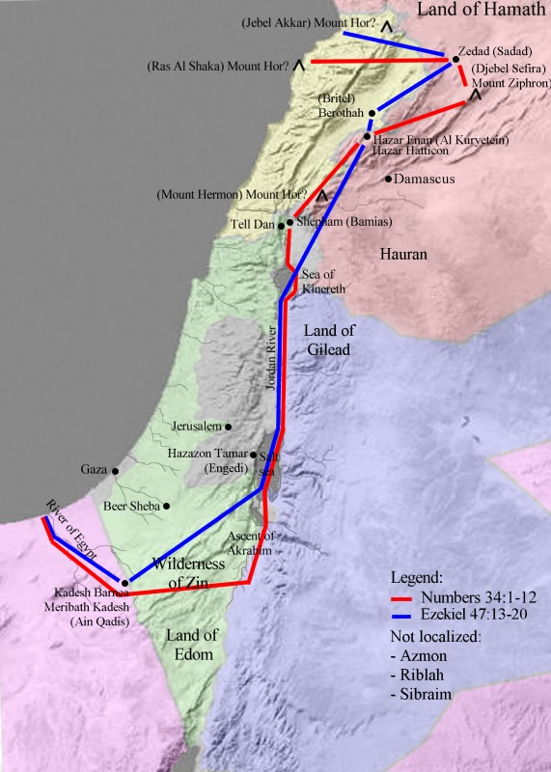
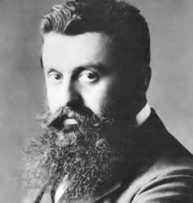
Zionism
Zionism began in 1896, Theodore Herzl published a pamphlet, The Jewish State, which derided the futility of assimilation of Jews into their host nations

Slide 7
Anti-Semitism in Europe
Herzl followed the Dreyfus Affair, a notorious anti-Semitic incident in France in which a French Jewish army captain was falsely convicted of spying for Germany.
He witnessed mass rallies in Paris following the Dreyfus trial where many chanted "Death to the Jews!"
Herzl came to reject his early ideas regarding Jewish emancipation and assimilation, and to believe that the Jews must remove themselves from Europe and create their own state.

Slide 8
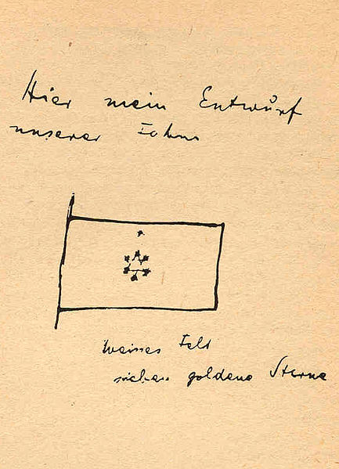
First Zionist Congress 1897
Herzl’s ideas were not well received initially by most Jews who doubted his credibility and considered him in rebellion against God
Through the efforts of Rev. Hechler and the Grand Duke, Herzl publicly met the Kaiser Wilhelm I in 1898.
The meeting significantly advanced Herzl's and Zionism legitimacy in Jewish and world opinion.

Slide 9
First Zionist Congress 1897
Conflicts arose between Orthodox and Reformed Jews over Zionism
secularists held that Jewish state could be anywhere
orthodox insisted return to Palestine was all-important
The First Zionist Congress was held in Basel, Switzerland in 1897: the delegates reached consensus that Palestine was the only choice with emotional appeal to Jews worldwide
the delegates worked to achieve other common goals

Slide 10
Zionism
Palestine part of Ottoman Empire, Herzl would have to get audience with the Sultan.
unfortunately, Jews view establishing a “colony” with the same indifference as Europeans
whereas Arabs had learned to abhor it (imperialism)
Zionists established several financial and political institutions that would support a Jewish colony in Palestine
May 17, 1901, Herzl did meet w/ Sultan Abdul Hamid II.
The Sultan refused Theodor Herzl's offers to consolidate the Ottoman debt in exchange for a charter allowing the Zionists access to colonize Palestine
as a counter offer, the Sultan would allow limited numbers of Jews to settle in Palestine, provided they would become Ottoman citizens

Slide 11
Zionism finds an Ally
disappointed, Herzl and his colleagues appealed to practically every government in Europe offering Jewish loyalty in exchange for help in securing a Jewish homeland in Palestine
Finally, Zionists made inroads with the British
Herzl died in 1904 while Dr. Chaim Weizmann took the leadership
Weizmann a chemist and naturalized British citizen was able to make headway where Herzl did not
developments leading to World War I set the stage for a new alliance between the Zionist and Britain

Slide 12
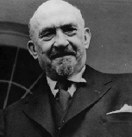
Chaim Weizmann
Accomplished chemist who developed use of bacterial fermentation to synthesize large quantities of chemicals such as acetone while at University of Manchester
Political career began in 1904 as he became leader of British Zionists, he pushed for establishment of Jewish institutions in Palestine
“A state cannot be created by decree, but by the forces of a people and in the course of generations. Even if all the governments of the world gave us a country, it would only be a gift of words. But if the Jewish people will go build Palestine, the Jewish State will become a reality—a fact.”

Slide 13
Weizmann Pushed Zionism Forward
Weizmann first visited Jerusalem in 1907, and while there, he helped organize the Palestine Land Development Company as a practical means of pursuing the Zionist dream.
Although Weizmann was a strong advocate for "those governmental grants which are necessary to the achievement of the Zionist purpose" in Palestine, as stated at Basel, he persuaded many Jews not to wait for future events.

Slide 14
World War Motivated Britain to Make Contradictory Promises
In the course of two short years, Nov 1915 to Nov 1917, Britain made promises to three separate parties that were totally contradictory
Each step was calculated to strengthen the British Empire without regard to the anguish it might cause others.
unforeseen complications and independent agreements between different diplomats made some of these conflicts inevitable
nevertheless, these conflicting promises contributed greatly to the unrest that developed between Palestitians, Arabs and Israel and continues even to this very day

Slide 15
World War I Brought Three Conflicting Promises
Hussein-McMahon Correspondence
promised establishment of independent Arab state in exchange for Arab cooperation with allies against Ottoman Empire
Balfour Declaration
promised establishment of independent Jewish state in Palestine
Sykes-Picot Agreement
divided the Fertile Crescent into three sections: northern under French control, southern under British control and Palestine under international control

Slide 16
World War I
When the Ottoman Empire entered WWI on the side of the Germans, France and Britain saw opportunity to make further strongholds
Using Indian troops the British invaded Mesopotamia (Iraq)
Arab Revolt led by Col. T Lawrence (famed “Lawrence of Arabia) in the Levant to secure Damascus and Jerusalem
Direct invasion of Turkey at the Battle of Gallipoli ended in a disaster for the British

Slide 17
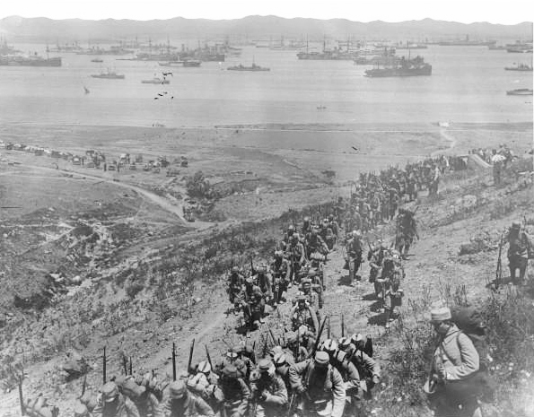
Gallipoli Campaign
April 25, 1915-Jan 9,1916
British and French naval and army forces attempted to take Constantinople and Dardanelles with large amphibious assault and failed, fraught with the difficulties of sweltering heat, widespread disease
Allied Forces failed to take the highlands and battles deteriorated into stalemated trench warfare
Casualties ran high on both sides:
Allies 220,000 killed/wounded (59%)
Ottoman/Germans 253,000 (60%) killed/wounded

Slide 18
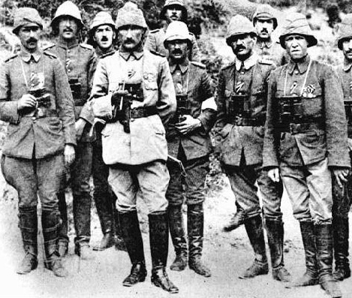
Gallipoli Campaign
Mustafa Kemal Ataturk became the front-line commander after correctly anticipating where the Allies would attack and holding his position until they retreated. he distinguished himself in battle and emerged as a national figure.
The battle is perceived as a defining moment in the history of the Turkish people: The struggle laid the grounds for the Turkish War of Independence and the foundation of the Republic of Turkey eight years later

Slide 19
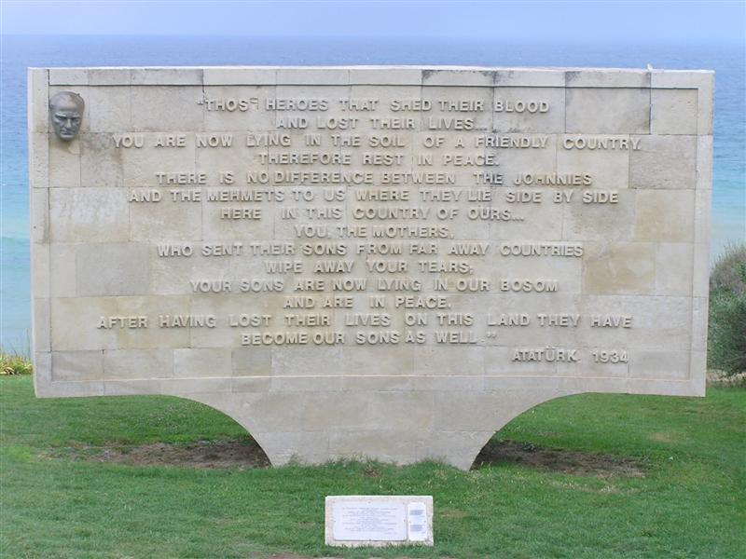

Slide 20
Arab Revolt
In World War I, in order to recruit Syrian Arabs to turn against their Ottoman masters, the British contracted with them with the promise to provide them lands from the spoils of war.
This uprising of Arabs stemming from Hijaz was led by Sharif Husayn of Mecca under direction of British high commissioner Sir Henry McMahon against the Ottoman empire starting in June 1916.
The desert war lasted two years assisted by British advisor Colonel T E Lawrence (Lawrence of Arabia).
The Husayn-McMahon Correspondence (promised Arab territories?) established relations between British and Jordan, Iraq and Arabia.
While British sought to protect India and Egypt (Suez),
Husayn sought to establish an Arab state.
The Correspondence is subject of great controversy: territorial promises to aspiring rebels.
In September 1918, as British forces invaded Damascus, Faisal (Husayn’s son) declared himself ruler of Syria. Unfortunately, Arab independence was never realized.

Slide 21
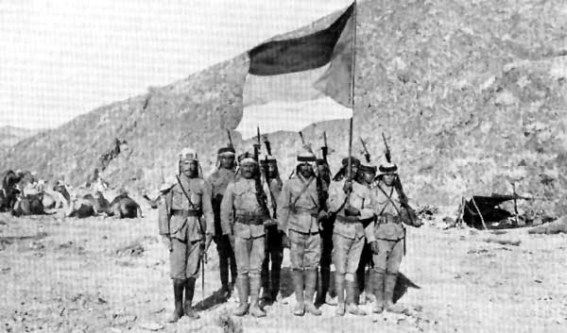
Arab Revolt

Slide 22
Husayn-McMahon Correspondence
from July 1915 to March 1916 Sharif Husayn (Hashemite Emir of Mecca) and Sir Henry McMahon (British High Commissioner in Egypt) exchange ten letters dealing with two priciple points:
Husayn promised to recruit Arabs to fight against the Ottomans
Great Britain promised to “support the independence of the Arabs”
Britain limited the boundaries of the Arab nation but the wording is very vague and subject of great controversy

Slide 23
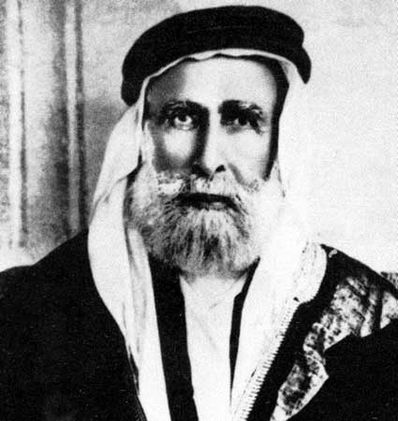
Sharif Husayn

Slide 24
Husayn-McMahon Correspondence
“portions of Syria lying to the west of the district of Damascus, Homs, Hama, Aleppo cannot be said to be purely Arab, and should be excluded”
Husayn understood this to be Lebanon in light of France’s interests in the region, but this was to be temporary as he expected Britain would help him negotiate with the French for it
McMahon later stated that this also excluded Palestine, that he had not “intended Palestine to be included in his pledge to King Husain”
In Paris after the war, the Arabs hotly contested that the promised lands meant the whole Mediterranean coast from Sinai to Turkey including Palestine
The issue was not settled until 1964 when the Westermann Papers which reviewed documents of British Foreign Office stated categorically that Palestine was included as part of British pledge to the Arabs

Slide 25
Trouble Ahead
in 1915, British political goals were to supplant the Ottoman Empire with a British-friendly independent Arab state in the Fertile Crescent
it is quite likely that Britain would have fulfilled this promise except changes occurred:
They were pressured by other European allies, especially France, to keep and share control over the Fertile Crescent after World War I
Russia further demanded an international state in Palestine because of the Russian Orthodox interests in Jerusalem. French agreed that international states should be formed in Jerusalem and Lebanon, but they wanted Syria.

Slide 26
Sykes-Picot Agreement
Upon learning of the Husayn-McMahon Correspondence, France sent Charles Georges-Picot on October 21, 1915 to secretly meet with British Diplomat Mark Sykes regarding French interests in the Middle East
Fertile Crescent was divided into three segments:
Palestine, per Russian/French desires would be international
Northern region would go to France
Southern region would go to Britain
There was no mention or regard for what had been promised to the Arabs
it is generally felt that Picot got a better deal than expected. Sykes came to feel this as well and it bothered him
Sykes-Picot was kept secret until the Bolsheviks made it public in November 1917
When Husayn asked British for an explanation, he was on 3 separate occasions assured by them that they would help establish an Arab state

Slide 27
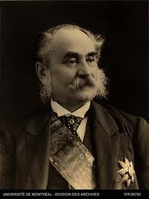
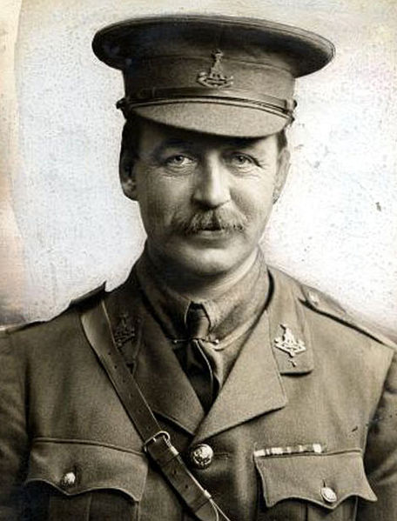
Charles Georges-Picot & Mark Sykes

Slide 28
Balfour Declaration
In 1917, Chaim Weizmann became president of the British Zionist Federation; he worked with Arthur Balfour to obtain the milestone Balfour Declaration,
which stated in part that the British government "views with favour the establishment in Palestine of a national home for the Jewish people...".
The declaration established an alliance between Zionists and Britain because there were still those in Britain who feared that the presence of France in Syria and Palestine jeopardized the Suez Canal link to India
Zionists argued all the while that a grateful Jewish government in Palestine would always remain an ally of the British Empire

Slide 29
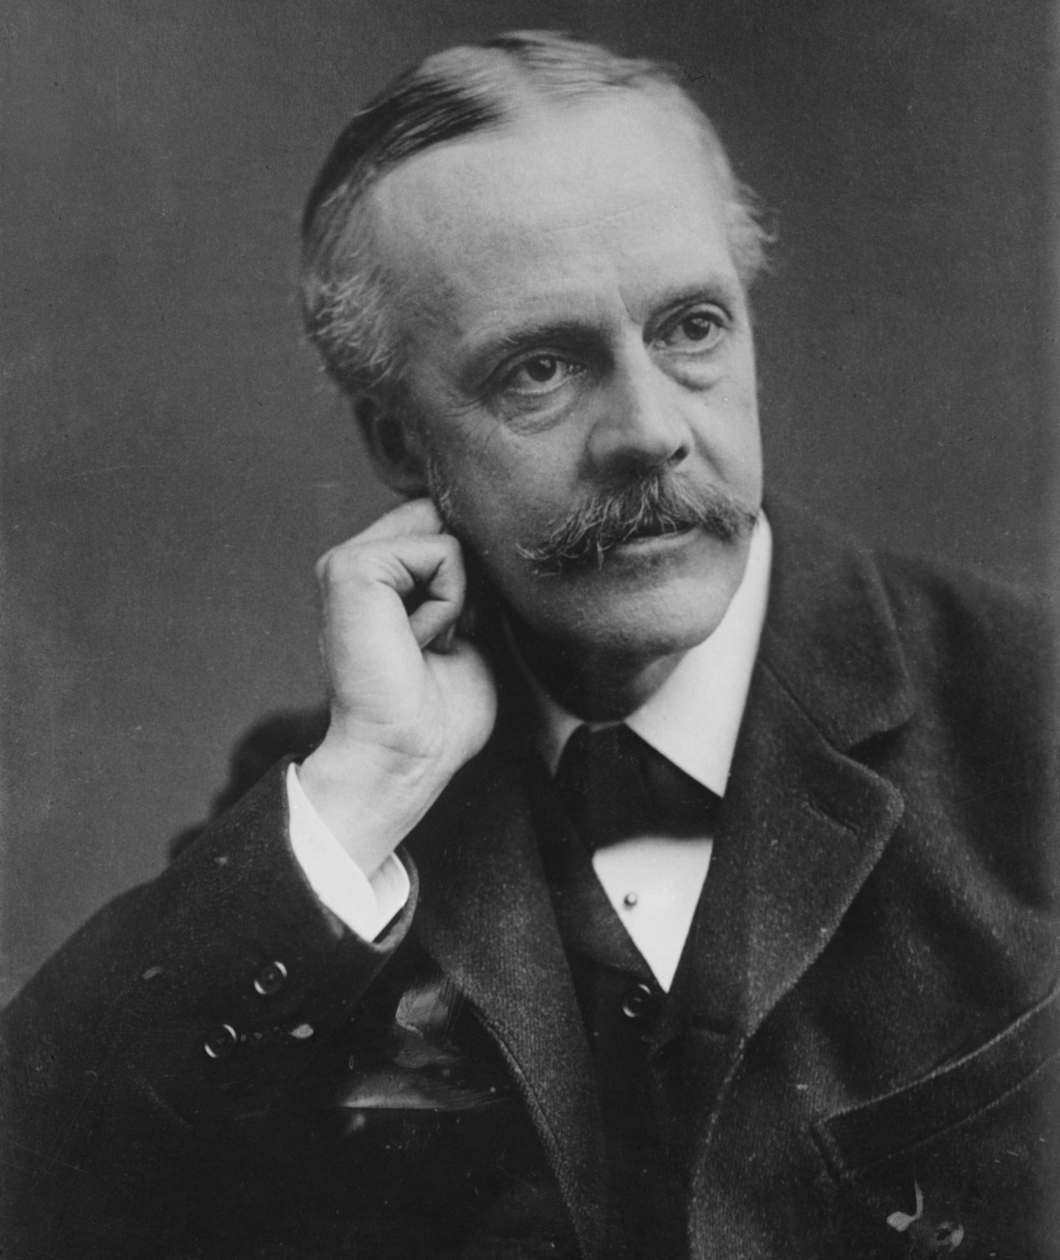
Arthur Balfour
Former Prime Minister of England from 1902-1905
Served as Foreign Secretary at the time of the Balfour Declaration under David Lloyd George
The "Balfour Declaration" was later incorporated into the Sèvres peace treaty with Turkey and the Mandate for Palestine

Slide 30
Balfour Declaration
Strongest objection to Zionism at the time was not from Arabs but anti-Zionist Jews of Britain, France and the United States
they feared that establishment of Jewish State would jeopardize the nationality status of Jews who were citizens of the countries of their birth
anti-Semitism would get worse, not better
Balfour Declaration reflects these fears: “His Majesty’s government view with favor the establishment in Palestine of a national home for the Jewish people, and will use their best endeavors to facilitate the achievement of this objective, it being clearly understood that nothing shall be done which may prejudice the civil and religious rights of existing non-Jewish communities in Palestine, or the rights and political status enjoyed by Jews in any other country”

Slide 31
Balfour Declaration
Emir Husayn was perplexed by the Declaration.
in 1918, the British sent Commander Hogarth of Arab Bureau to Cairo to assure him that the Jewish settlement of Palestine would be allowed only if it was compatible with the freedom of the existing population
He emplored Husayn to accept the Zionists because “the friendship of world Jewry to the Arab cause is equivalent to support in all states where Jews have political influence.”
A joint Anglo-French proclamation in 1918 promising Arabs a government “freely chosen by the population” gave Husayn the assurances he desired

Slide 33
Disaster at Paris Peace Conference
After World War I was over a new war broke out around the peace table in Paris:
three different sides battled over the Fertile Crescent: the allies, the Zionists and the Arabs
the victorious allies on one side began to battle among themselves:
The British fumed against their French allies
the French insisted on implementing Sykes-Picot
but they had not done any of the fighting in Middle East and British forces occupied all of Fertile Crescent
French landed 20,000 occupation troops in Lebanon & demanded British leave
the reluctant British regretted making the agreement and there were accusations and recriminations that flew between them and the French

Slide 34
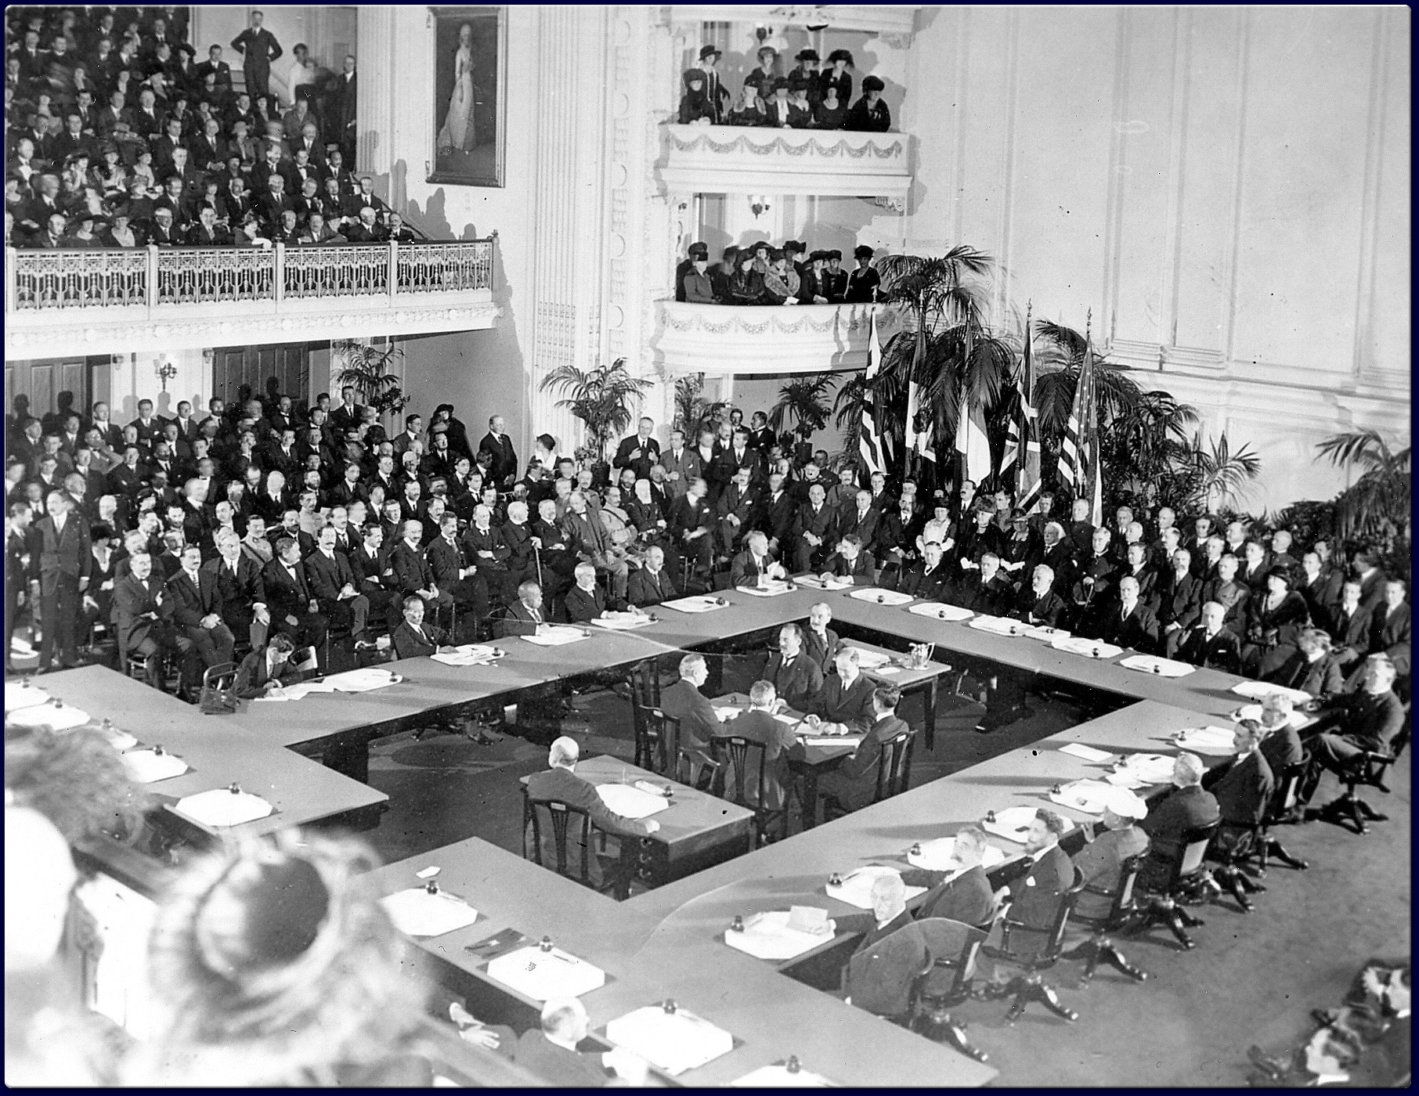

Slide 35
Zionists at Paris
Having men of prominence within the “Big Four” at the Paris Peace Conference, Zionists had huge advantage over the Arabs
Not willing to let the Balfour Declaration remain a secret agreement, they carefully presented it as five-point proposal and saw to it that the parts of the Declaration were implemented as a matter of policy in the treaties relating to the Middle East
Dr. Chaim Weizmann was the leading delegate
Some 300 prominent Jews in US opposed Zionist plan and wrote to President Wilson against it

Slide 36
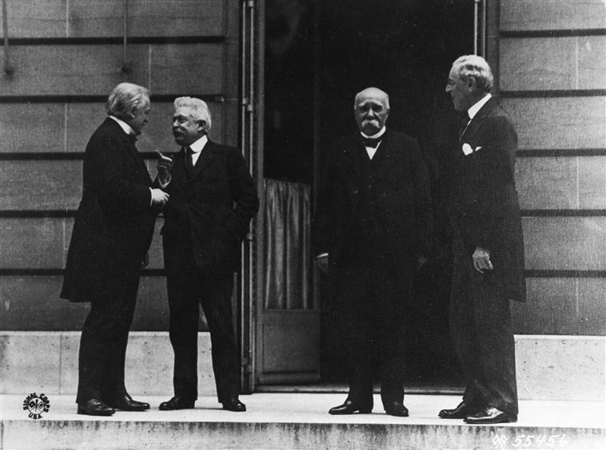
Big Four
David Lloyd George,
Vittorio Orlando,
George Clemenceau
Woodrow Wilson

Slide 37
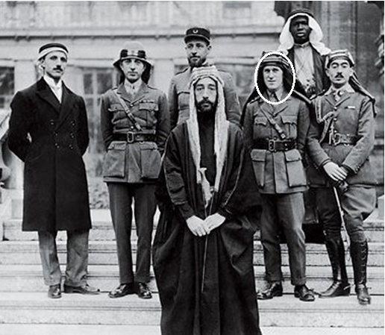
The Arab Delegation
The elder Emir Husayn sent son Faysal (who did most of fighting) as head of Arab delegation
Col T E Lawrence 3rd from right was chief advocate for the Arab cause, acting as translator
They wanted the independence promised by British, having kept their end of the bargain and argued for Wilson’s principle of self determination

Slide 38
Forces Weakening Arab Position
Catholic Maronites and other Christian minorities in Fertile Crescent feared an Arab-controlled state and found a strong advocate in French delegation
“Syrian Commission” opposed Faysal
Arab leaders in Baghdad were rivals with Arab leaders in Damascus, were unwilling to have one common government, but rather a federation of two states
Zionists and Anglo-French coalition rejected principle of self-determination being applied to Arabs

Slide 39
Faysal Begins to Concede
While in London just before Paris Conference, Faysal first fully learned of Sykes-Picot and was furious
British treated him well and tried to persuade him to accept the French in Syria/Lebanon
he met Dr. Chaim Weizmann and had cordial discussions with the Zionists there
He felt that Zionist’s promises to protect rights of Arab farmers in Palestine, survey the area to make economic improvements for all and to help with the creation of an “Arab state” were sufficient to consider making a preliminary agreement with them

Slide 40
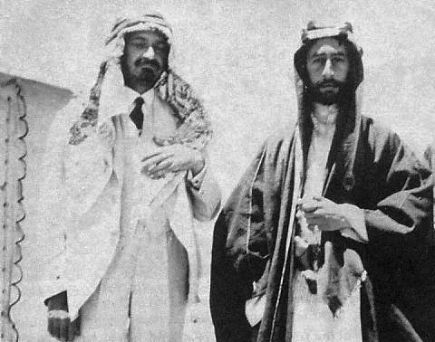
Disaster at Paris Peace Conference
On 3 January 1919, Weizmann and the Hashemite Prince Faysal signed the Faisal-Weizmann Agreement attempting to establish favorable relations between Arabs and Jews in the Middle East.
This agreement would have averted all the subsequent bloodshed, terrorism and feuding that persists to the present if it had not been rendered null and void by Sykes-Picot, which opposed the creation of Arab state.

Slide 41
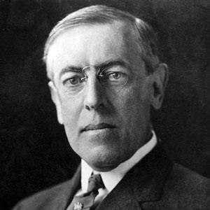
Disaster at Paris Peace Conference
President Wilson was a strong advocate for self-determination of nations who were formerly under axis powers (incl. Ottomans)
His fourteen points called for the nullification of all previous secret agreements (Sykes-Picot and Balfour) and est. of commissions to study wishes of indigenous populations (incl. Arabs)
European delegates were predisposed to implement the mandate system of Sykes-Picot but to minimize tension with American delegates, agreed to compromise:

Slide 42
Disaster at Paris Peace Conference
Arabs were “not ready” for self-government but the mandate system of League of Nations would “tutor” them until they were ready
Wilson agreed to this with the understanding that this was not “rejection of self-determination but merely postponement of it”
Still, Wilson was not comfortable with which powers should have the tutorship of which people
He proposed a commission should be sent by League of Nations to study this question
France refused, Britain abstained, Zionists opposed

Slide 43
King-Crane Commission
In August 1919, President Wilson independently sent an American team, the King-Crane Commission to fulfill the task.
The Commission concluded that the Arabs were not ready to be an independent state but warned that the populations might rebel against a mandate of former imperial countries (i.e. Britain and especially France).
Because of the American belief in self-determination, the US would be the only logical choice as administrator of the mandate and tutor of the Arab leaders
the commission came to the conclusion that while independence was preferred, the Americans were considered the second-best choice for a colonial power, the British the third-best, and the French easily the worst possible choice

Slide 44
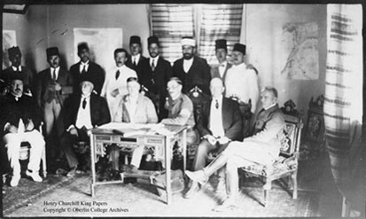
King-Crane Commission

Slide 45
King-Crane Commission
Concerning Zionism, the only way to establish a viable Jewish state would be with armed force to enforce it. This was precisely what the Commission wanted to avoid, so they dismissed the idea, saying that Zionists anticipated "a practically complete dispossession of the present non-Jewish inhabitants to Palestine".
That said, there would be nothing wrong with Jews coming to "Israel" and simply living as Jewish Syrian citizens, but noted “…the erection of such a Jewish State [could not] be accomplished without the gravest trespass upon the civil and religious rights of existing non-Jewish communities in Palestine."

Slide 46
Disaster in Paris Concludes
The proposal was viewed as childish by the French and British delegates, who did not believe that public opinion, in the European and American sense, existed in the Middle East.
by the time the commission was ready with its report, Wilson’s health was failing and was in no position to defend it
The Paris Peace Conference concluded with the establishment of mandate system per Sykes-Picot and granted the wishes of Zionists. The Arabs were just out of luck.
Every one of Wilson’s fourteen points was rejected except the establishment of League of Nations and even that, the American Congress refused to ratify

